Slide 1



Fundamentals of Optoelectronics
（光电子学基础）
Prof. Zongyin Yang （杨宗银）
College of Information Science and Electronic Engineering,
Zhejiang University （浙江大学信息与电子工程学院）
Email：yangzongyin@zju.edu.cn
Website: optoelectronicszju.com
2025 春夏学期

Slide 2
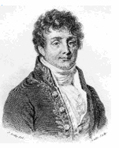
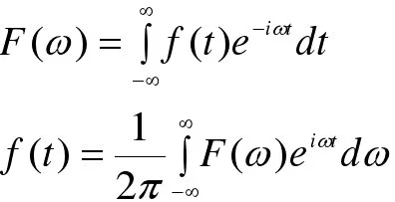
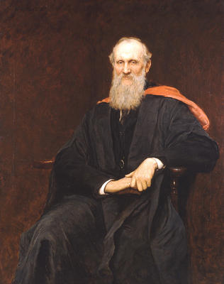
Fourier Transform
In 1821, Joseph Fourier claimed that any function, whether continuous or discontinuous, can be expanded into a series of sines.
“Fourier’s theorem is not only one of the most beautiful results of modern analysis, but it may be said to furnish an indispensable instrument in the treatment of nearly every recondite question in modern physics.”
Lord Kelvin
(1824 – 1907)

Slide 3
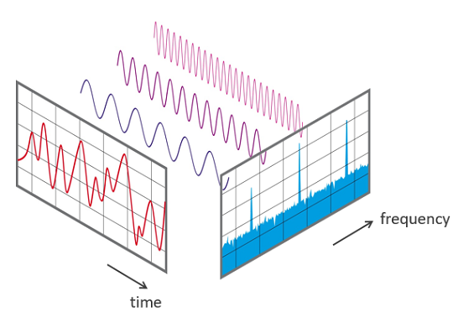
Fourier Transform
Fourier analysis is one of the most important mathematical techniques, maybe the most important mathematical technique, ever developed for science. Nearly every single field of science benefits from it.
In simplest terms, the Fourier transform is an approach for computing what frequencies are present in a wave—in particular, the spectrum—from its dependence on time.

Slide 4
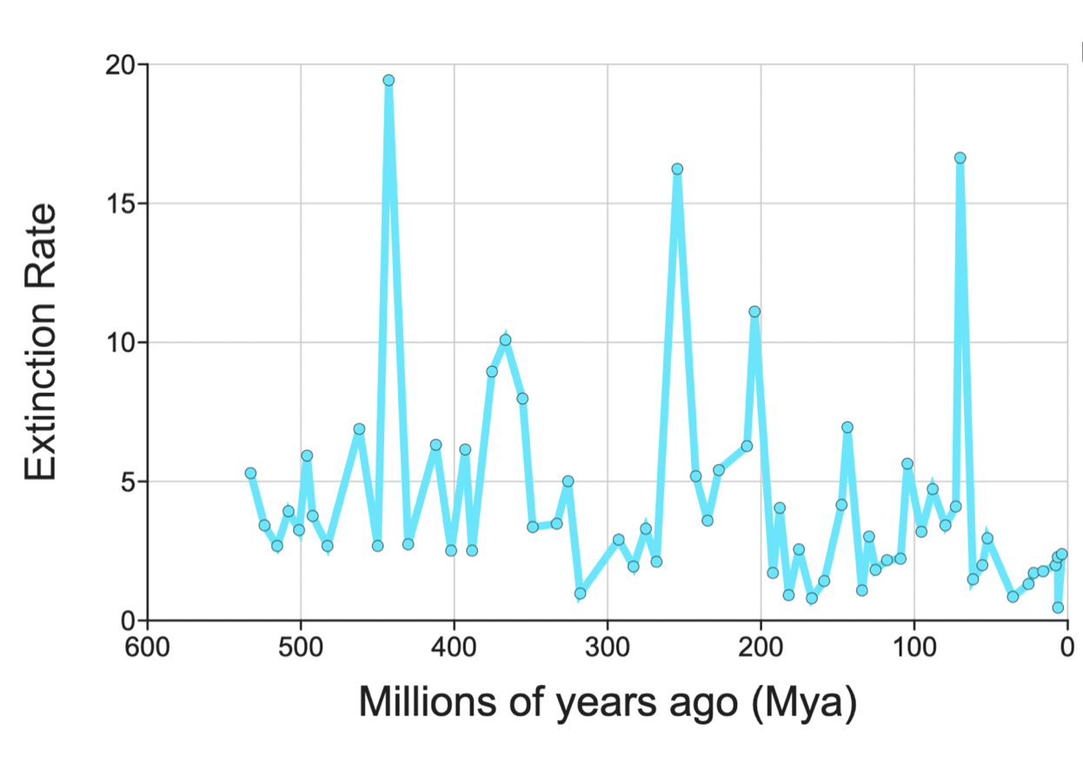
Some examples of Fourier Transform
Archaeologists know the species extinction rate over many million years.
So, when can we expect the next one?
FT of Extinction Rate
Peak at 1/(26Myr)
Why 26 million years?
0
Frequency (1/Myr)

Slide 5
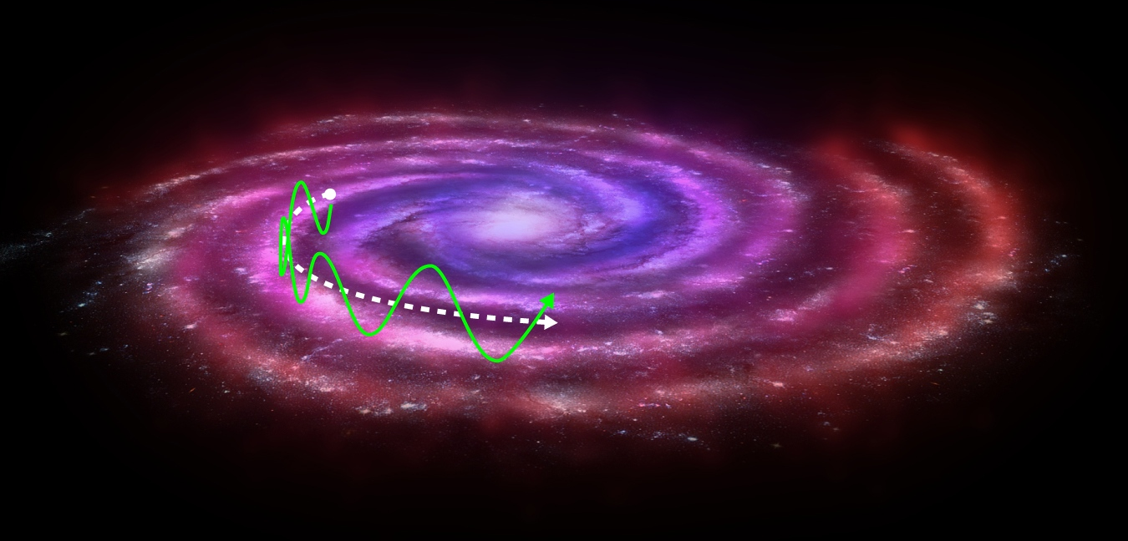
Some examples of Fourier Transform
Why would asteroids and comets tend to strike earth every 26 million years?
Our solar system revolves（绕转） around the center of our galaxy.
But it also oscillates through the galactic plane（银道面）—with a 52 million-year period.
Every 26 million years, the earth crosses the galactic plane—encountering much higher-density regions of the galaxy and hence many more asteroids.

Slide 6
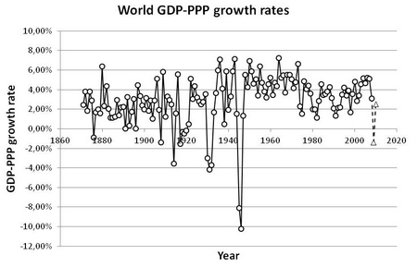
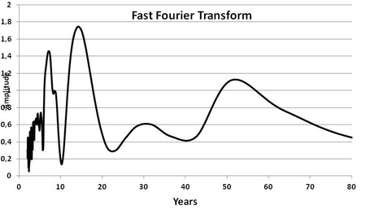
Some examples of Fourier Transform
World Income Growth Rate vs. Time
World’s Income Growth Rate vs. Time and Its Fourier Transform
Growth Rate
Year
Fourier Transform Magnitude of World Income Growth Rate vs. Time
Knowledge of preferred frequencies could help governments prevent crashes and individuals invest wisely.
Amplitude
Frequency (1/Year)

Slide 7
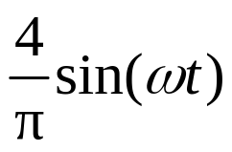
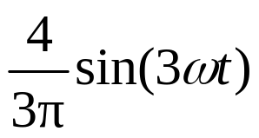
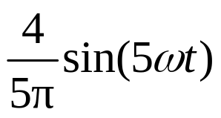
Fourier series
Fourier Decomposing Functions
One term:
1
π/ω
t
Here, we write a
square wave as
a sum of sine waves of different frequencies.
Two terms:
1
π/ω
t
The sharp corners require very high frequencies.
Three terms:
1
π/ω
t

Slide 8
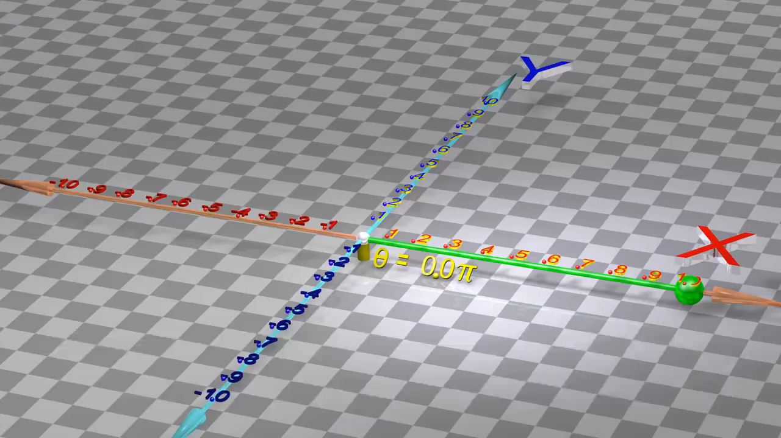
Fourier series
e指数是旋转，三角函数是波，两个同频的三角函数合成出来还是三角函数，
解释光在玻璃里变慢原因
到10:17秒停止

Slide 9
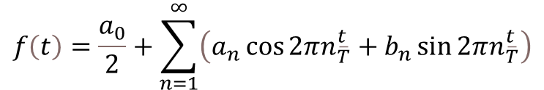
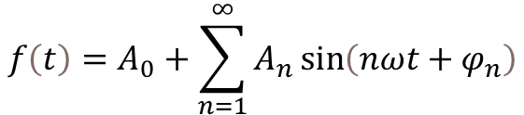


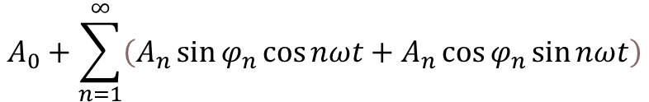


Fourier series and Fourier transform
$$f\left(t\right)=A_{0}+\sum_{n=1}^{∞}{A_{n}\sin\left(nωt+φ_{n}\right)}$$
利用三角恒等式：
$$\sin\left(a+β\right)=\sin{\operatorname{acos}{β}}+\cos{\operatorname{asin}{β}}$$
$$A_{0}+\sum_{n=1}^{∞}{\left(A_{n}\sin{φ_{n}\cos{nωt}}+A_{n}\cos{φ_{n}\sin{nωt}}\right)}$$
$$ω=\frac{2π}{T}$$
$$a_{n}=A_{n}\sin{φ_{n}}$$
$$b_{n}=A_{n}\cos{φ_{n}}$$
$$f\left(t\right)=\frac{a_{0}}{2}+\sum_{n=1}^{∞}{\left(a_{n}\cos{2πn_{\overline{T}}^{t}}+b_{n}\sin{2πn_{\overline{T}}^{t}}\right)}$$
a₀/2 is the average value of the function f(t)
在周期无限大的极限下，系数 a_{n} 和 b_{n} 转化为函数 F(ω) 的形式，这个函数称为傅里叶变换，它描述了在所有连续频率上的幅度和相位。

Slide 10
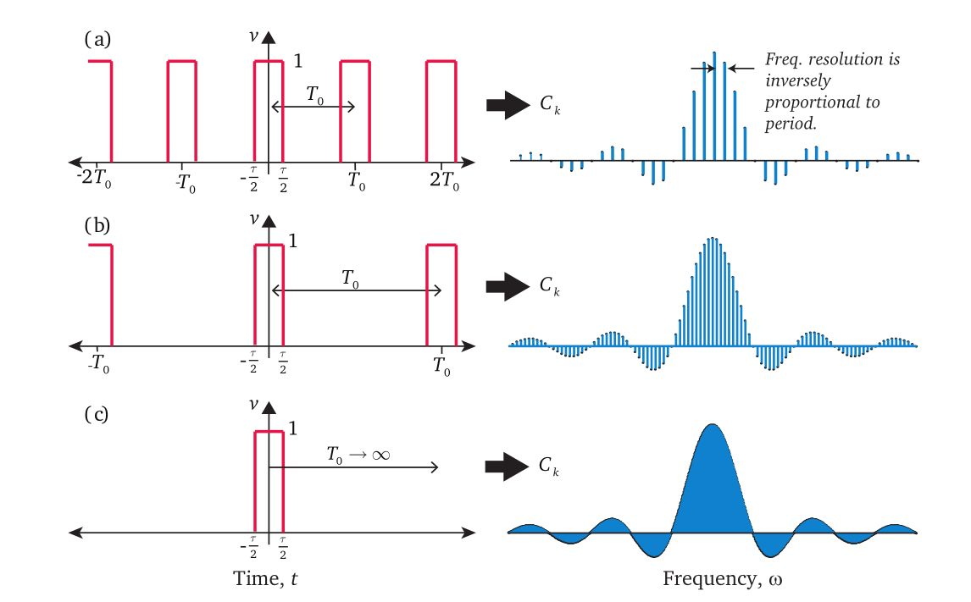
Fourier series and Fourier transform
Fourier series for periodic functions, and Fourier transform for functions that are not periodic. The Fourier transform is a generalization of Fourier series.

Slide 11
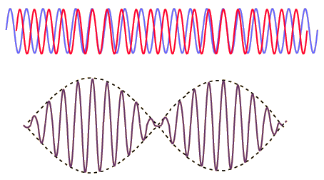
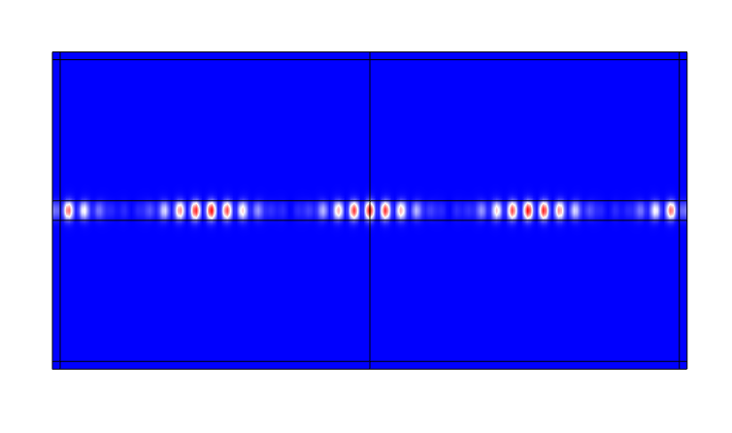
Essence of Fourier Transform
拍频（Beat frequency）现象是指当两个频率接近但不完全相同的波形相互叠加时，产生的结果波形会显示出一种振幅随时间缓慢变化的模式。这种效果源于两个波形的相位差随时间变化，导致在某些时刻它们相长干涉（增强），而在其他时刻相消干涉（减弱）。
当两个频率相近的信号混合时，它们的拍频可以用来提取原始信号的频率和相位信息。

Slide 12
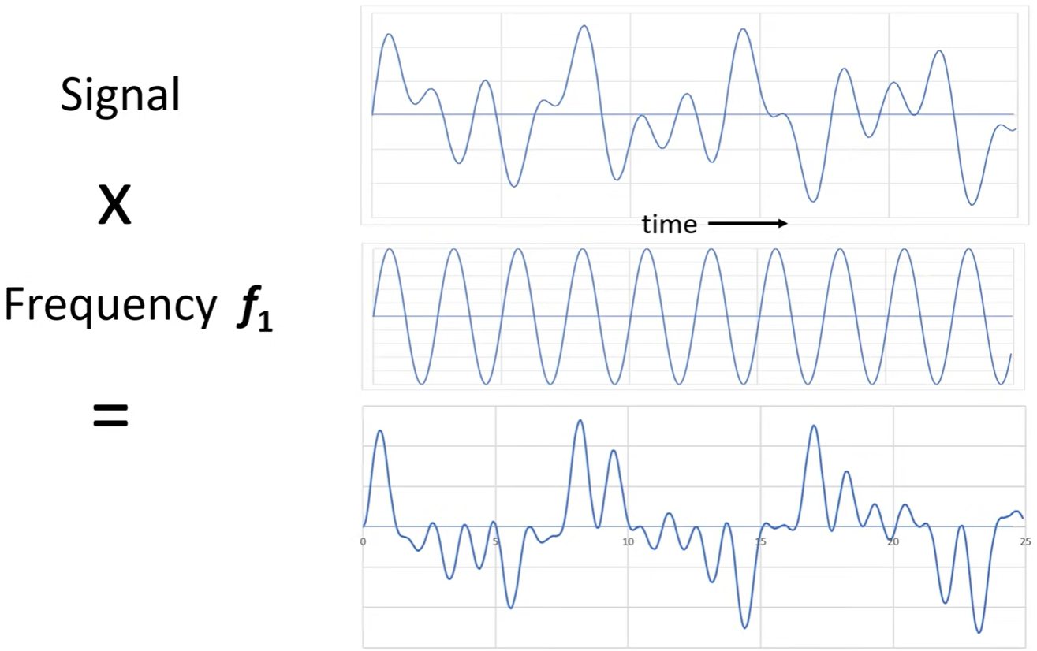
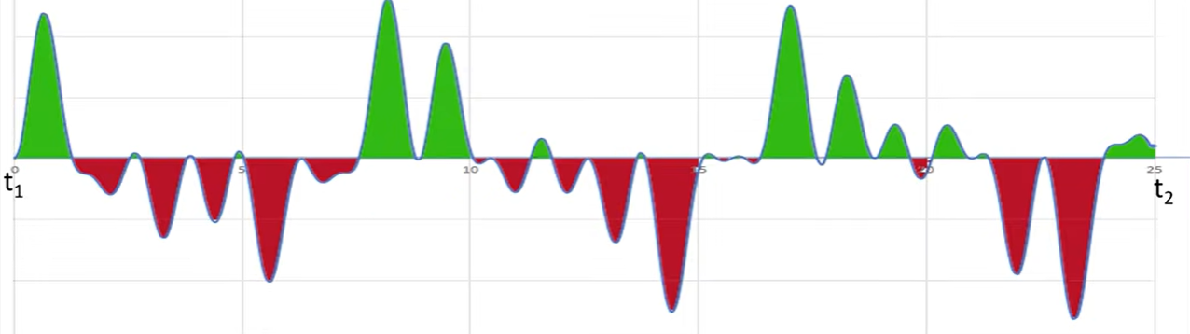
Essence of Fourier Transform
Integrate all the values over time.
If the frequency under examination is not present in the signal, the sum will be zero because the positive and negative values will cancel each other out over time.

Slide 13
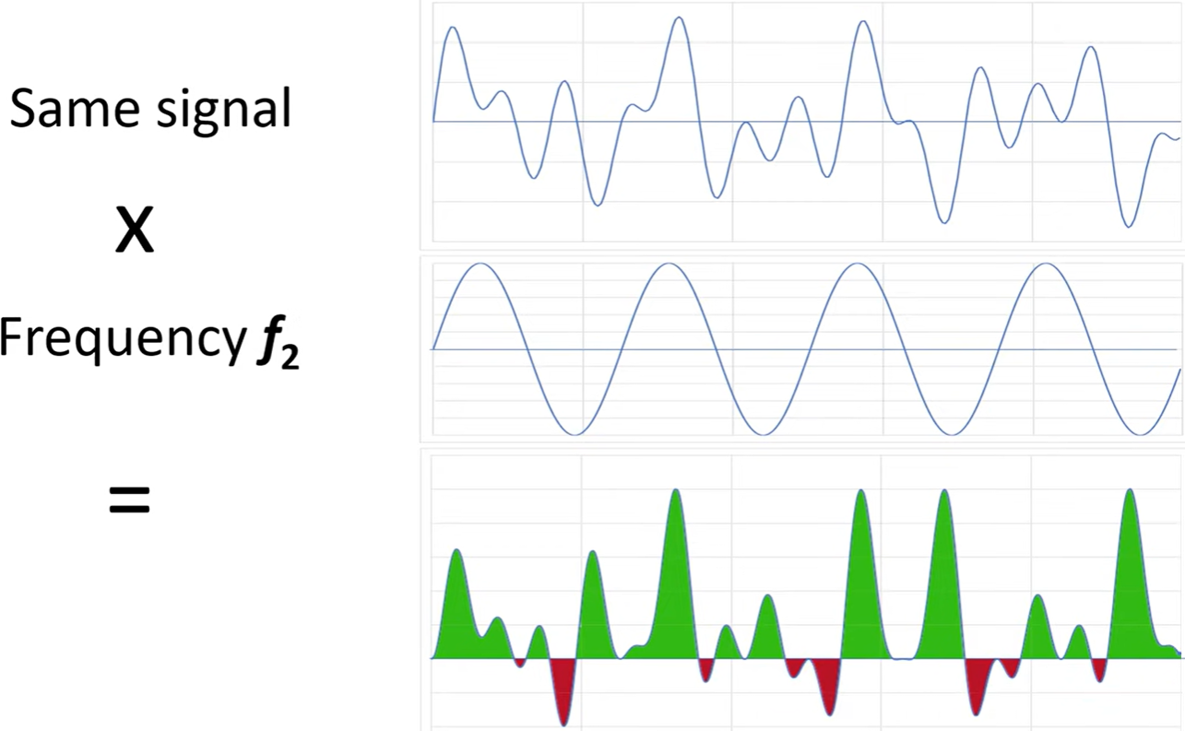
Essence of Fourier Transform
Do the same integration for a frequency which actually is present in the signal, the net value will be much larger.

Slide 14
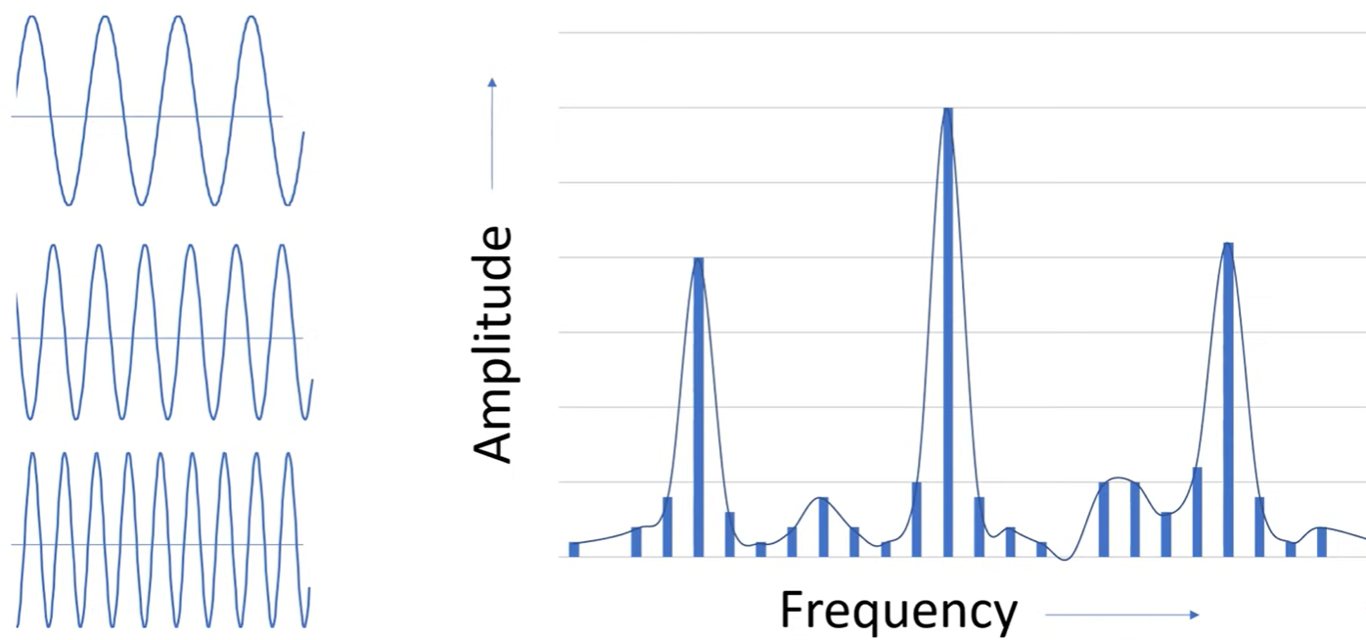
Essence of Fourier Transform
By repeating this multiplication and integration process for a large number of frequencies, we can construct a frequency spectrum.

Slide 15
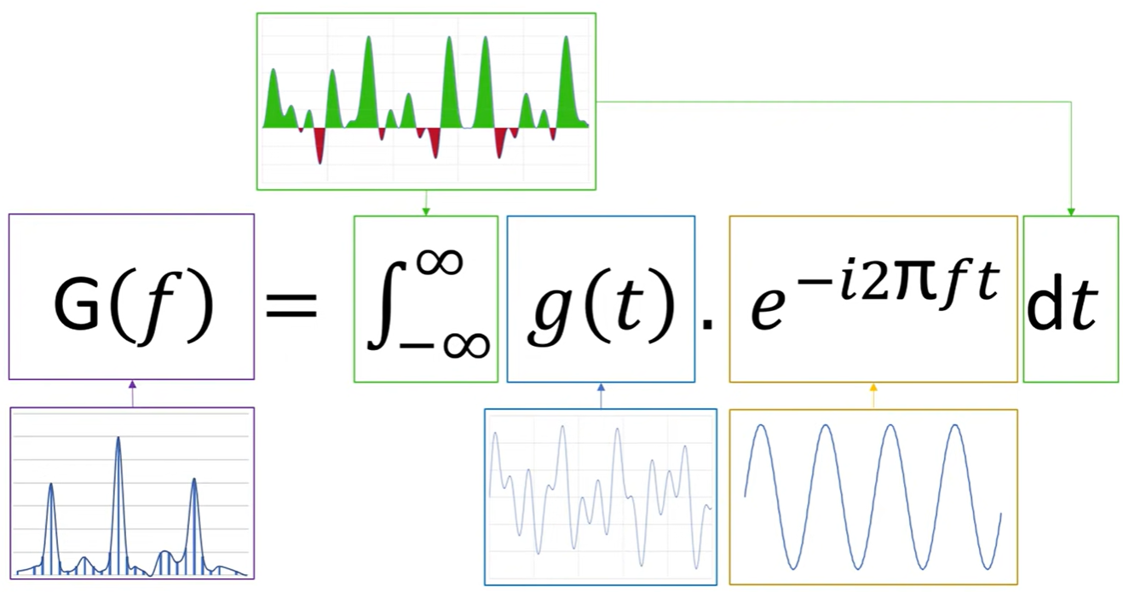
Essence of Fourier Transform
This process can be described by the Fourier Transform formula.
This multiplication is integrated over time.
Euler’s formula!
Spectrum as a function of the frequency G(f)
Signal as a function of time g(t), which includes phase 𝜑 of each frequency
Complex harmonic function with frequency f , also include phase information

Slide 16
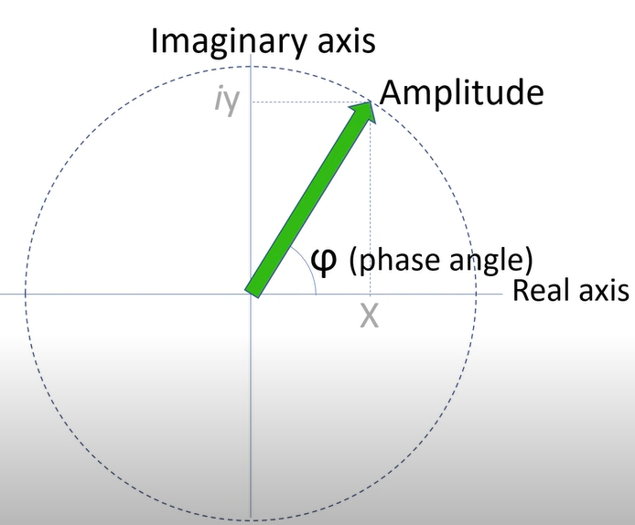
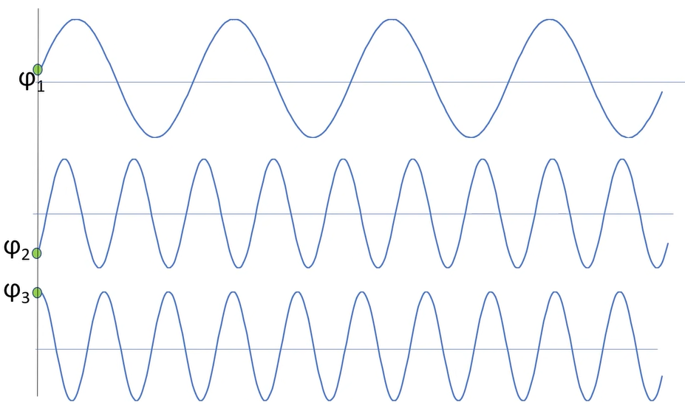
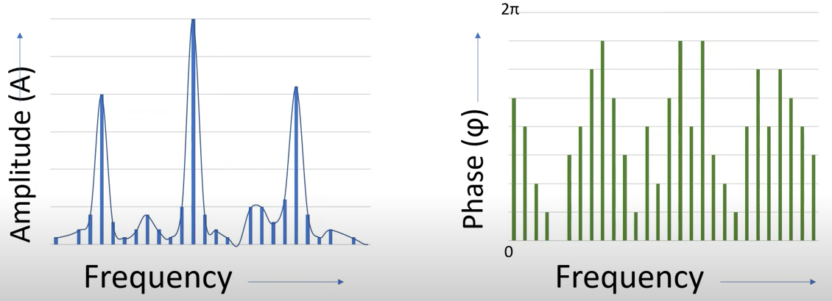

Essence of Fourier Transform
$$e^{iφ}=cosφ+isinφ$$
Fourier transform contains both amplitude and phase information.

Slide 17
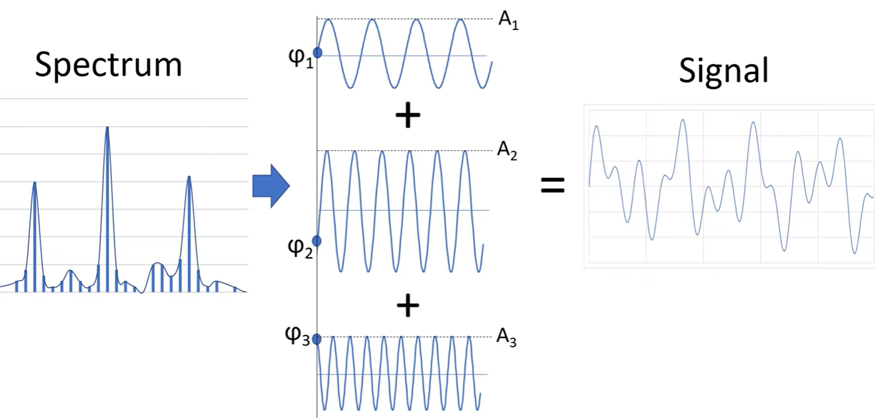
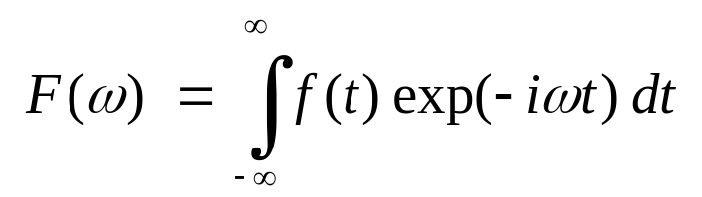
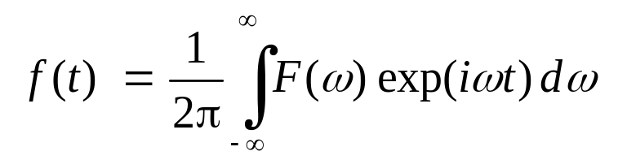
Inverse Fourier Transform
So, we can transform to the frequency domain and back. Interestingly, these transformations are very similar.
Fourier Transform
These equations together are Fourier’s Theorem.
Inverse Fourier Transform

Slide 18
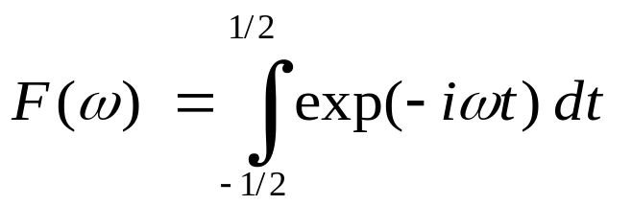
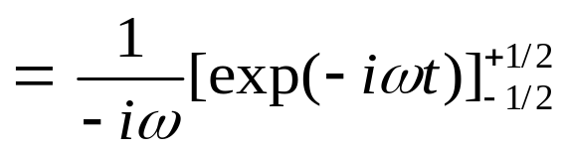
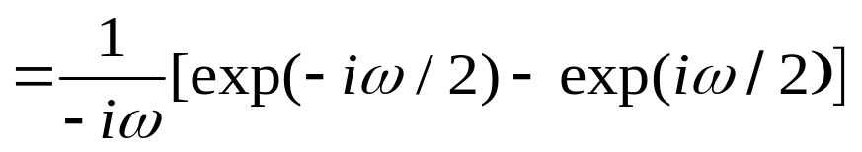
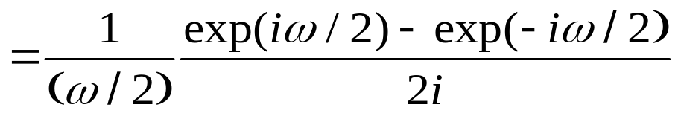
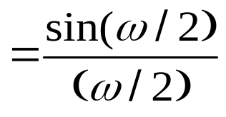


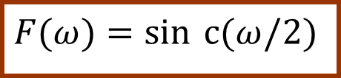
Fourier Transform of a Rectangle Function, rect(t)
=1
1
rect(t)
-.5 0 .5
t
1
sinc(ω/2)
Zeros at ω = 2nπ (n ≠ 0)
$$\operatorname{sinc}{x}=\frac{\sin{x}}{x}$$
ω
$$F(ω)=\sin{​}c(ω/2)$$
The sinc function is important in optics.
Note that F extends out to ±∞ due to the discontinuities in rect(t).

Slide 19
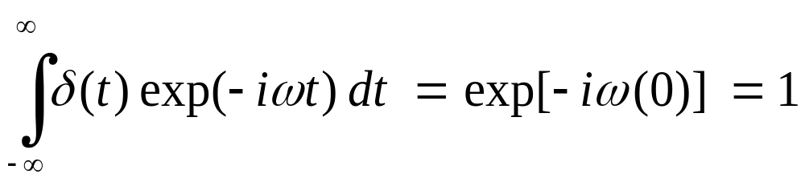
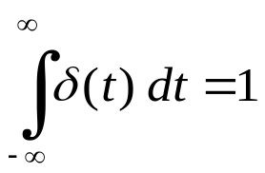
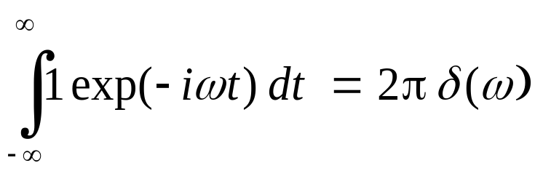
The Fourier transform of Dirac δ-Function δ(t) is 1
δ(t)
1
0
t
ω
And the Fourier Transform of 1 is 2πδ(ω):
1
2πδ(ω)
t
0
ω

Slide 20
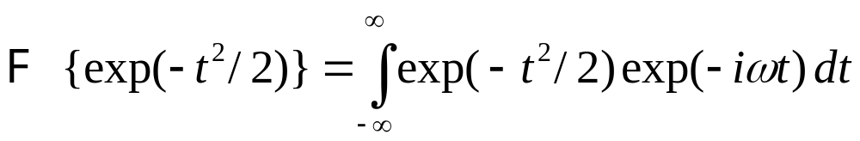
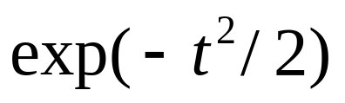
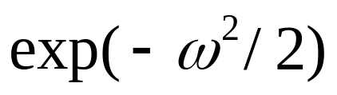
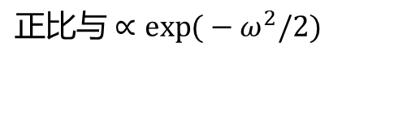
Fourier transform of a Gaussian, exp(-t²/2), is itself!
$$正比与∝\exp{(}−ω^{2}​/2)$$
∩
0
t
0
ω

Slide 21
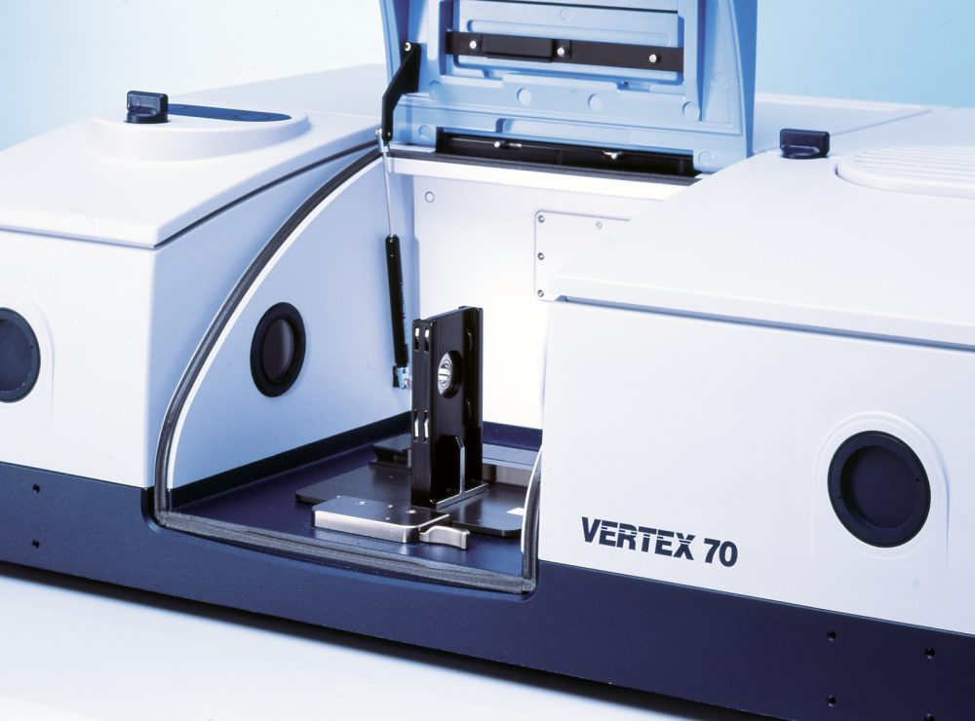
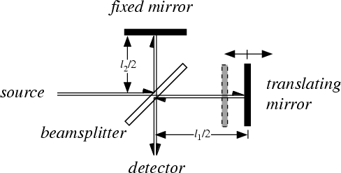

Example：Fourier Transform Spectroscopy
对于单色光来说，若其入射波长为λ，波数为σ（σ=1/λ），入射强度为2B(σ)，经过半透半反镜后，光束分为强度相等（B(σ)）的两束，假设两路光程差为x，当x改变时，其干涉强度关于波数呈余弦函数关系，则像面上两点的强度可以表示为：
$I\left(x\right)=2B(σ)[1+cos⁡(2πxσ)]$
干涉公式

Slide 22
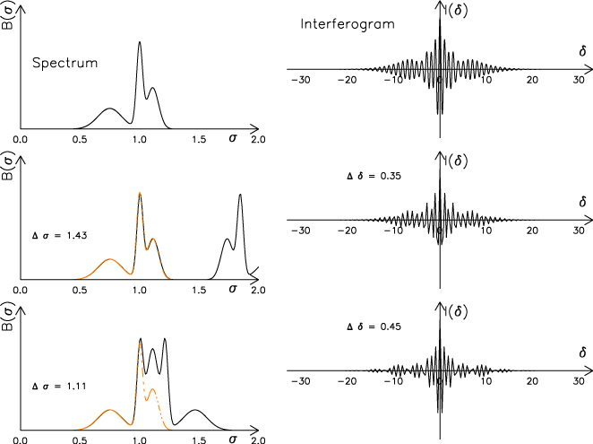
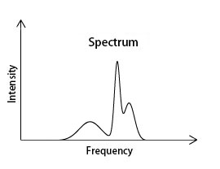
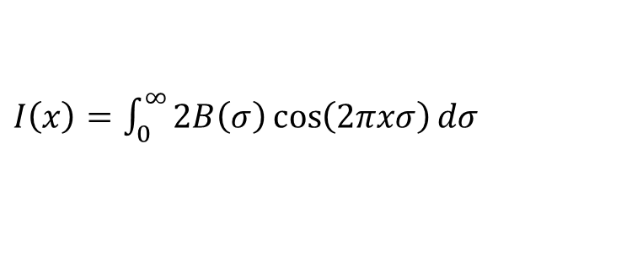

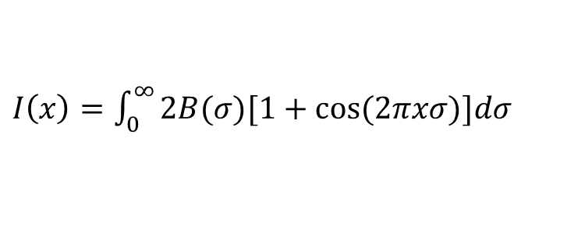
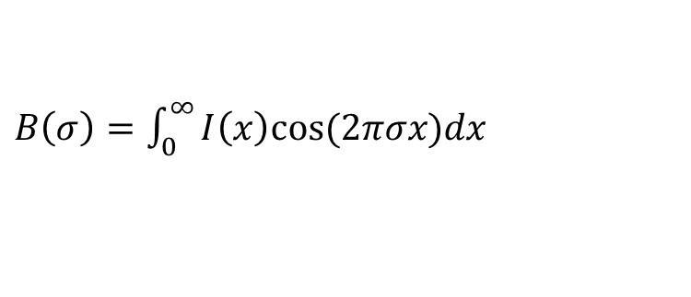
Example：Fourier Transform Spectroscopy
当光源中含有多种频率的光时，探测器上光强可表示为
$I\left(x\right)=\int_{0}^{∞}{2B(σ)[1+cos⁡(2πxσ)]dσ}$
减去强度的平均值$(偏置)2B(σ)$，得到
$I\left(x\right)=\int_{0}^{∞}{2B\left(σ\right)\cos\left(2πxσ\right)dσ }$
利用傅里叶反变换在计算机上求解得到光谱，由于B(σ)系数不影响光谱成分，可去除2，反变换公式：
$B\left(σ\right)=\int_{0}^{∞}{I\left(x\right)cos⁡(2πσx)dx}$

Slide 23
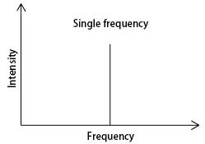



Example：Fourier Transform Spectroscopy
Beats

Slide 24

Example：Fourier Transform Spectroscopy

Slide 25


Example：Fourier Transform Spectroscopy
Infinite periodic function
High spectral resolution
1
rect(t)
Low spectral resolution
-.5 0 .5
t
Short optical path difference (OPD)
Convolution of rectangular function

Slide 26

Example：Fourier Transform Spectroscopy
傅里叶变换光谱仪通常用于检测红外波段的吸收或发射光谱，工作原理是使用干涉仪来调制到达单个探测器上的光，再通过傅里叶变换将探测器上收集到的干涉图转换为与波长相关的光谱。傅里叶变换型光谱仪具有杂散光低、分辨率较高、光通量大、精度高等优点，使得微型化的同时满足高光通量和高分辨率等性能的要求。
2.3 傅里叶型微光谱仪
思考：为什么红外光谱仪大部分是傅里叶型的，很少用光栅色散？
1. 多通道（Fellgett’s advantage）: 所有光谱同时到达探测器，能量比色散/滤光后的强，减少探测时间，噪声较低。
2. 高光通量（Jacquinot advantage）: 光路简单，不需要狭缝，整体进光亮较高。
3. 高测量精度（Connes advantage）：FTIR光谱仪的光学结构简单,干涉仪只有一个动镜是运动部件,通常动镜是在无摩擦的空气轴承上移动,其运动又受高度稳定的He-Ne激光干涉系统监控,因此测量的重复性和准确度都很十分高。

Slide 27



Example：Fourier Transform Spectroscopy
微型傅里叶光谱仪核心就是scan the Optical Path Difference (OPD),可分为两类：一类是时间调制型；另一类是空间调制型。
2.3 傅里叶型微光谱仪-时间调制
M. Herzig et al., Opt. Lett. 24, 1705 (1999)
传统FTIR也是时间调制型，由驱动器控制迈克尔逊干涉仪的反射镜运动以获得干涉曲线。
通过MEMS工艺做成片上傅里叶型微光谱仪。
动镜通过静电、电磁力、电热驱动移动。

Slide 28



Example：Fourier Transform Spectroscopy
2.3 傅里叶型微光谱仪-时间调制
美国Si-Ware公司的时间调制傅里叶型微光谱仪
合肥南巢科技的时间调制傅里叶型微光谱仪， 6 nm分辨率

Slide 29




Example：Fourier Transform Spectroscopy
2.3 傅里叶型微光谱仪-时间调制
尺寸49×57×76 mm
分辨率5.7 nm
日本滨松公司的时间调制傅里叶型微光谱仪C15511-01
移动距离有限，分辨率有限，稳定性差

Slide 30


Example：Fourier Transform Spectroscopy
2.3 傅里叶型微光谱仪-时间调制
没有动镜的基于集成波导的平面片上傅里叶变换光谱仪。这些系统没有采用迈克尔逊结构，而是基于马赫-曾德尔干涉仪(MZIs)，Mach-Zehnder干涉仪中光被分裂到至少两个单向通道，然后进入同一个探测器并被重新组合，由于光在不同通道的光程差不同，因此相位差也不同，便产生了干涉。
连续调制的Mach-Zehnder干涉仪可以通过电光调制铌酸锂波导实现，也可以通过热光学效应实现，比如在集成光路附近嵌入微型加热器。
M. Souza et al., Nature Communications 9, 665 (2018)
MZI 干涉仪，通过加热其中一个波导臂改变光程差，无移动部件，稳定

Slide 31

Example：Fourier Transform Spectroscopy
2.3 傅里叶型微光谱仪-时间调制
A. Li et al., Laser Photonics Review 15, 2000358 (2021)
光引科技的傅里叶型微光谱仪方案

Slide 32

Example：Fourier Transform Spectroscopy
2.3 傅里叶型微光谱仪-时间调制
数字傅里叶变换光谱仪使用了一个具有许多光开光的光子电路，将光信号沿着不同长度的路径传递。在此，光谱分辨率取决于路径的数量或光谱通道数，其与光开关的数量成指数关系。
D. Kita et al., Nature Communications 9, 4405 (2018)
MIT的数字MZI 干涉仪，通过多个光开关调节光路从而调节光程差，无移动部件

Slide 33


Example：Fourier Transform Spectroscopy
2.3 傅里叶型微光谱仪-空间调制
A. Manuilskiy et al., SPIE 6395, 639504 (2006)
吕金光 等. 光学学报, 38, 0230001 (2018)
静态傅里叶型光谱仪，通过空间位置的改变得到光程差序列，无须扫描实现干涉信号的空间调制。

Slide 34

Example：Fourier Transform Spectroscopy
2.3 傅里叶型微光谱仪-空间调制
王新强 等. 应用光学, 41, 462 (2020)
空间外差型，通过两个光栅对不同波长的路径差，实现干涉信号的空间调制。

Slide 35




Example：Fourier Transform Spectroscopy
2.3 傅里叶型微光谱仪-空间调制
基于多个Mach-Zehnder干涉仪阵列，形成空间调制。例如，螺旋状的波导阵列，波导的长度线性变化，从而引起光程差。
但是，此类系统的光谱分辨率受到最大光程差以及Mach-Zehnder干涉仪数量的限制，这都限制了光谱仪在保持高性能的同时尽可能的微型化。
A. Velasco et al., Optics Letters 38, 706 (2013)
A. Bermello et al., Optics Letters 44, 5840 (2019)
M. Florjanczyk et al., Optics Express 26, 18178 (2007)
不同光程差的多个Mach-Zehnder干涉仪阵列空间调制。
机器学习提高光谱范围和分辨率。

Slide 36

Example：Fourier Transform Spectroscopy
2.3 傅里叶型微光谱仪-空间调制
驻波集成傅里叶变换光谱仪有两种工作方式：
一种为单反式，即进入波导的光经反射镜反射后与入射光干涉，形成驻波；
另一种为相遇式，即从波导的两边分别入射光波，干涉形成驻波。将微型探测器集成到波导上，每个像元就可以采集到一定的干涉信号。
探测器像元尺寸限制了系统的光谱分辨率。
E. Coarer et al., Nature Photonics 1, 473 (2007)
驻波集成傅里叶变换光谱仪

Slide 37


Example：Fourier Transform Spectroscopy
2.3 傅里叶型微光谱仪-空间调制
D. Pohl et al., Nature Photonics 14, 24 (2020)
干涉位置通过电压可调，解决驻波集成傅里叶变换光谱仪欠采样问题，提高分辨率

Slide 38


Example 2：Fourier Optics
Fourier optics methods can be visualized by considering the Fraunhofer diffraction pattern of a single slit. The diffraction process transforms the slit in the object plane to a diffraction pattern in the distant image plane. This diffraction pattern contains information about the slit in a form in which smaller spatial details (narrower slits) are transformed into larger spatial displacement in the image plane (broader diffraction patterns). Smaller spatial detail can be referred to as a higher "spatial frequency", and the diffraction pattern produces a plot in which greater distance from the optic axis implies greater spatial frequency. This kind of transformation, where a plot of light distribution is transformed into plot of spatial frequency is an example of a Fourier transformation and is a conceptual starting point for Fourier optics.
Fourier transform of the single slit (rectangular function)

Slide 39


Fourier Transform with Respect to Space
If f(x) is a function of position x, we can define a spatial Fourier transform from x to k.
f(x)
f(t)
We refer to k as the spatial frequency.
x
t
F {f(x)} = F(k)
F(k)
F(ω)
And the inverse spatial Fourier transform is now:
k
ω
Everything we’ve said about Fourier transforms between the t and ω domains also applies to the x and k domains.

Slide 40
Fourier series and Fourier transform
Fourier series for periodic functions, and Fourier transform for functions that are not periodic. The Fourier transform is a generalization of Fourier series.

Slide 41




Example：Fourier Optics
2.1 色散型光谱仪-基本原理
Double-slit interference
λ
双缝干涉条纹交叠，而光栅的干涉图案是分立的点或线
With the assumption that x >> d, we can write the condition for constructive interference as:
m λ ≃ d sin θ
where m = 0 (θ = 0), 1（θ₁）, 2（θ₂）,.....

Slide 42


Example：Fourier Optics
2.1 色散型光谱仪-基本原理

Slide 43



Example：Fourier Optics
2.1 色散型光谱仪-基本原理
光谱分辨率判断标准-Rayleigh Criterion：两个峰间距等于其中一个峰的半高全宽
where N(每毫米刻线数) is the total number of slits illuminated and m is the order of the diffraction.

Slide 44



Example：Fourier Optics 数学描述
The Huygens–Fresnel principle (named after Dutch physicist Christiaan Huygens and French physicist Augustin-Jean Fresnel) states that every point on a wavefront is itself the source of spherical wavelets, and the secondary wavelets emanating from different points mutually interfere. The sum of these spherical wavelets forms a new wavefront.

Slide 45


Example：Fourier Optics 数学描述

Slide 46

Example：Fourier Optics 数学描述

Slide 47

Example：Fourier Optics

Slide 48

Example：Fourier Optics

Slide 49

Example：Fourier Optics

Slide 50

Example：Fourier Optics

